Slide 1





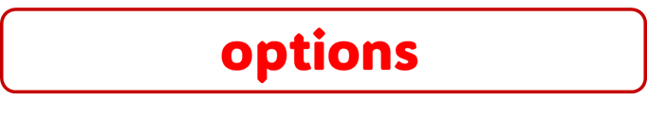










skin
KG
TRICK BOX
about dev
continue
continue
skin
new game
continue
new game
quit
continue
options
about dev
quit
options

Slide 2



| LEVEL-SELECT MENU
Go Back

Slide 3
Go Back

Slide 4
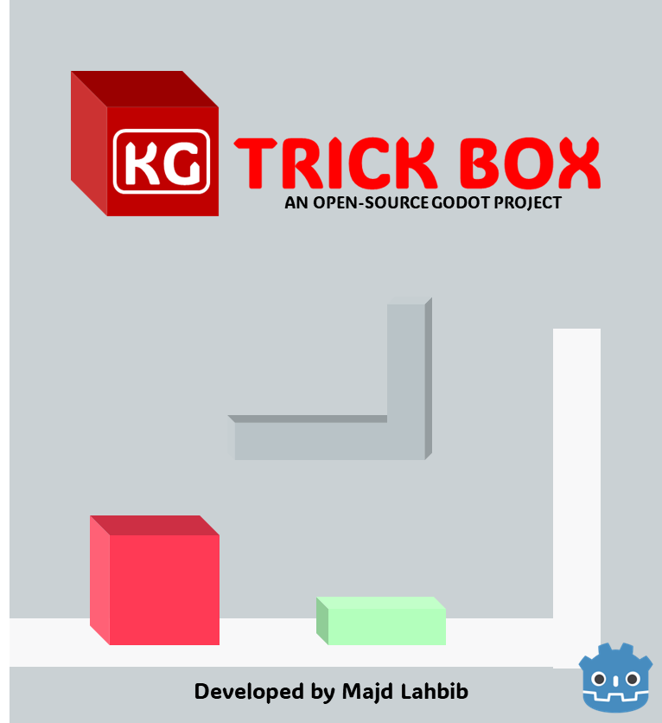
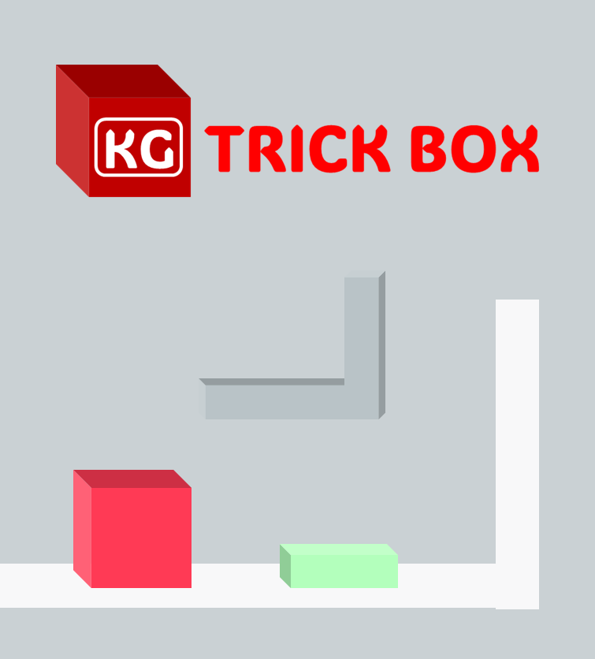

AN OPEN-SOURCE GODOT PROJECT
Developed by Majd Lahbib

Slide 5
KG
TRICK BOX

Slide 6

GAME PAUSED
CONTINUE
OPTIONS
MAIN MENU
QUIT

Slide 7

TRICKBOX
CONTINUE
CONTINUE
OPTIONS
MAIN MENU
QUIT

Slide 8



| OPTIONS
X
Graphics Settings:
Control Settings:
Help:
Save

Slide 9
| OPTIONS

Slide 10



| OPTIONS
X
Display
Full Screen:
Screen Resolution:
Save
You can contact me on:
@LahbibMajd
@MajdLHB

Slide 11

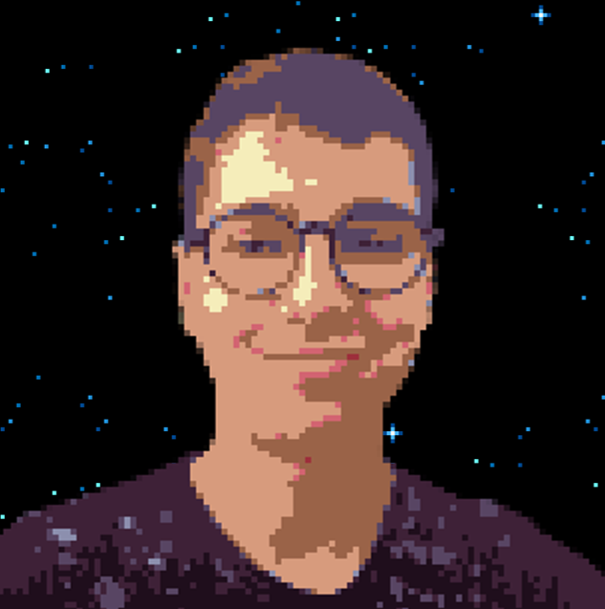
| ABOUT DEVELOPER
X
Developer:
This game is developed by Majd Lahbib in a short period of time in goal to learn Godot.
Game project:
This project is open-source. You can get it from @MajdLHB GitHub profile.
Feel free to make your version of the game by adding levels or you can just get things from the project
© Majd Lahbib 2024 - MIT license – Game Version 1.0 PC

Slide 12
| ABOUT DEVELOPER
This game is developed by Majd Lahbib in a short period of time in goal of learning Godot.
This project is open-source. You can get it from @MajdLHB GitHub profile.
Feel free to make your version of the game by adding levels or you can just get things from the project
© Majd Lahbib 2024 - MIT license – Game Version 1.0 PC

Slide 13
















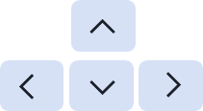


L
w
A
S
D
ESC

Slide 14


L
Accept
w
Move up
Back
A
Move left
Pause
S
Move down
Navigate
D
Move right
Move up
ESC
Pause / Back
Move down
Accept
Move left
Navigate
Move right
Rotate CAM
Navigate
Rotate camera

Slide 15
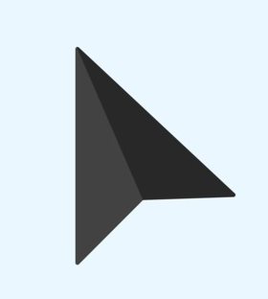

Slide 17
DEVELOPED BY MAJD LAHBIB
IN GODOT 4
THANKS FOR PLAYING THE DEMO!
THE FULL GAME WILL LAUNCH ON ITCH.IO
THIS IS AN OPEN-SOURSE GODOT PROJECT
YOU CAN FIND ON @MAJDLHB GITHUB ACCOUNT
IT’S MY FIRST TIME WITH GODOT
AFTER USING UNITY FOR A LONG TIME
AND UNREAL ENGINE 4 ONCE BEFORE

Slide 18
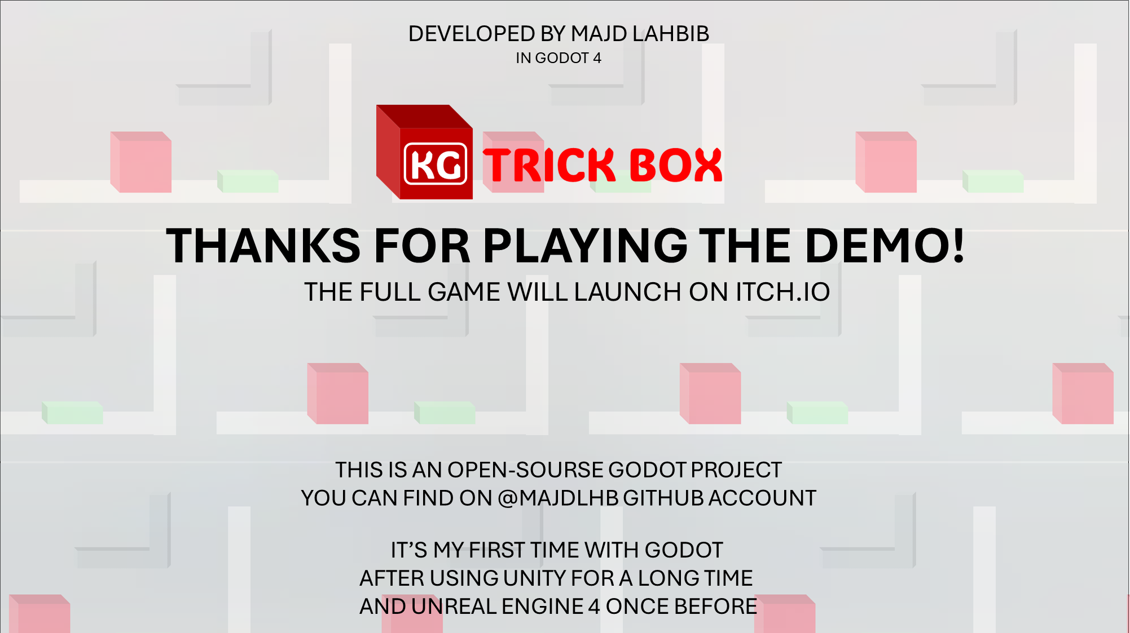

Slide 19





